Slide 1
Azure Bulk Download APIs
Architecture

Slide 2






Azure Bulk Download APIs: Logical Flow
3
Azure Function APIs
APIs themselves only allow connectivity from the API Gateway source IP address and not directly. These requests also leverage service-to-service authentication (Managed Identity), and the API Management gateway is the only account with permissions to access the APIs.
The APIs can create READ shared access signatures to individual file(s) on the Azure Storage Account.
4
Start Download
Download requests are initiated through the getFile API.
The API uses the customer's name and source IP address in the HTTP header request to list and download the files associated with that customer.
The API creates a short-lived shared access signature for authentication.
The shared access signature is only valid for the individually requested file and only accepts connections from the clients' source IP address.
The getFile API performs a 302 redirect directly to the Data Lake Storage Account and the requested blob using the shared access signature.
2
Authenticated & Proxied API Requests
API requests are proxied through the API Gateway. Customer Subscription keys are validated and the customer's name is appended to the HTTP header request sent to the Azure Functions API.
Azure
Customer Data
APIs
API Gateway
5
File Storage
Each customer has their own Container in the Azure Storage Account. These container names map to the customer’s name in API management and are used by the API as a security control.
Azure Storage
Azure Functions
API Management
Customers
Logging
Log Analytics
1
Customer API Entry
Customers connect through the single API Gateway endpoint. Customers are authenticated here using a Subscription ‘key’.
https://{apim-hostname}/listFiles API– List all the files associated with the customer. Files are listed in JSON format with the filename, full download path, creation time, and MD5.
https://{apim-hostname}/getFile?path={filename} API – Download the requested file.

Slide 3
Azure Bulk Download APIs: Logging, Monitoring, & Telemetry
Azure Functions
All requests, telemetry, and runtime information is logged to Log Analytics and Application Insights.
API Management
All requests and telemetry are logged to Log Analytics and Application Insights.
Azure
Customer Data
APIs
API Gateway
Azure Storage
All requests and telemetry are logged to Log Analytics
Azure Storage
Azure Functions
API Management
Customers
Logging
Log Analytics

Slide 4
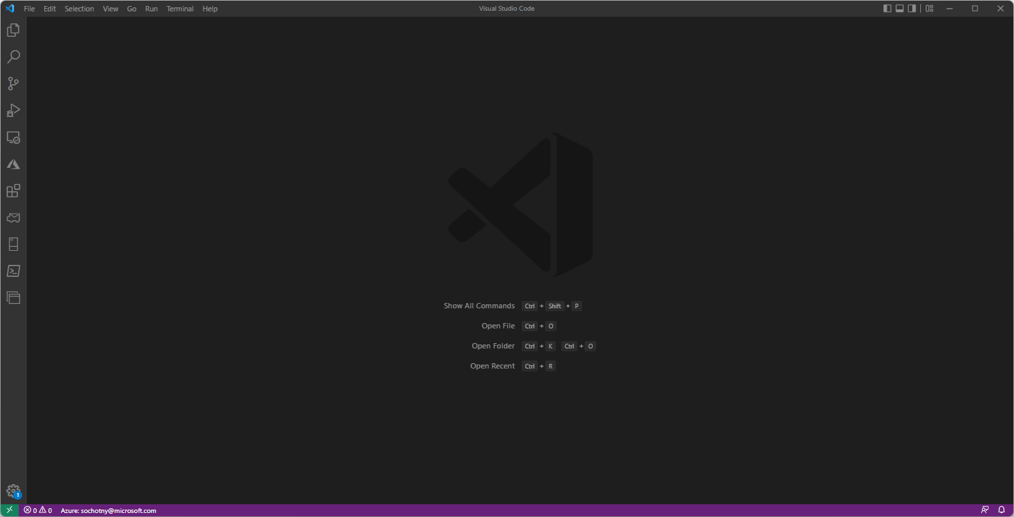
Azure Bulk Download APIs: API Code Deployment

Slide 5
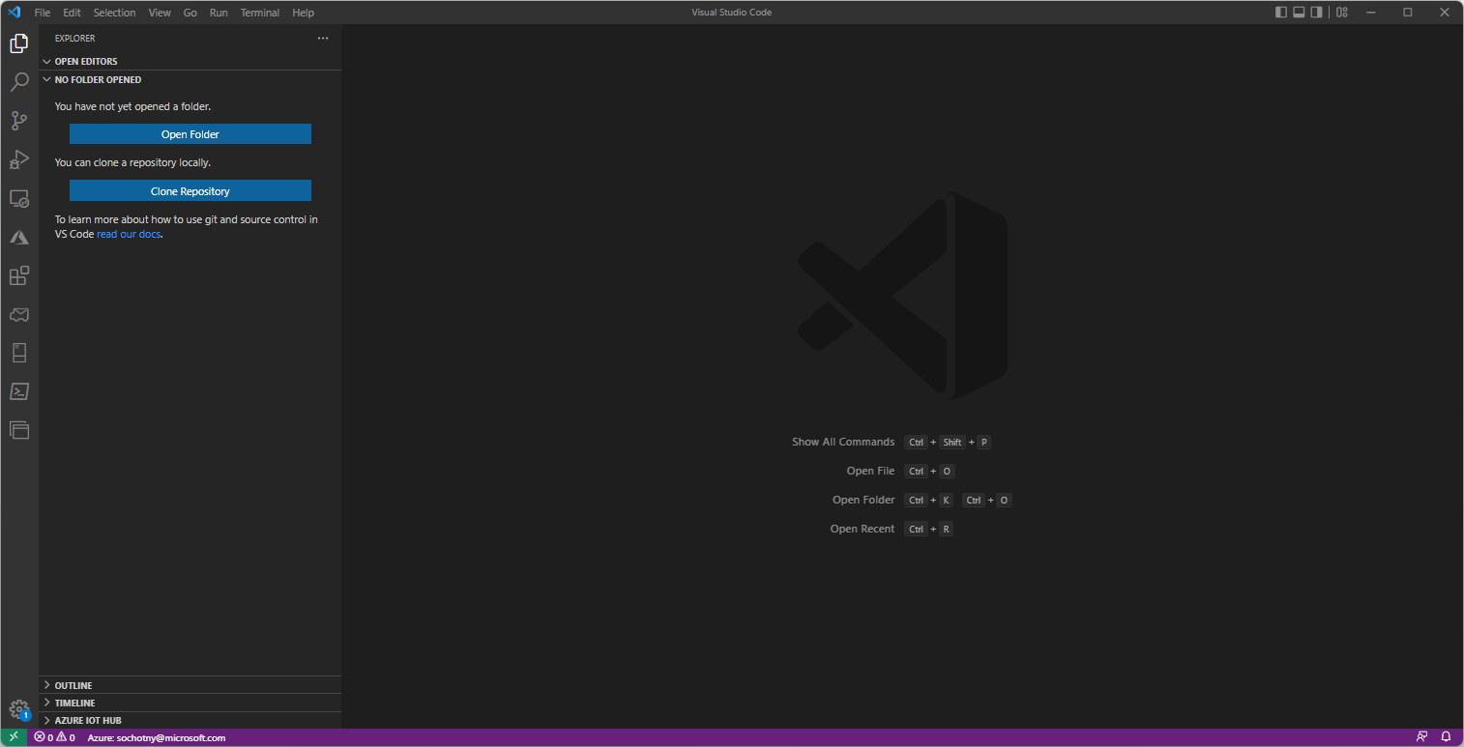
Azure Bulk Download APIs: API Code Deployment

Slide 6
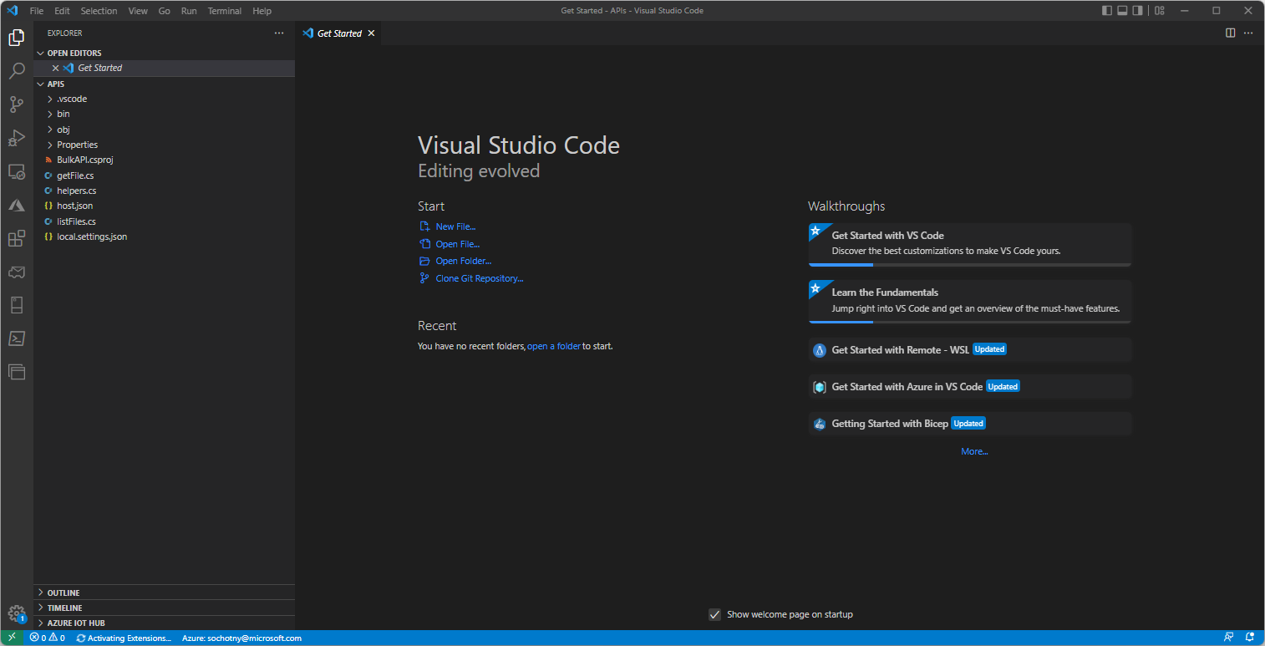
Azure Bulk Download APIs: API Code Deployment

Slide 7
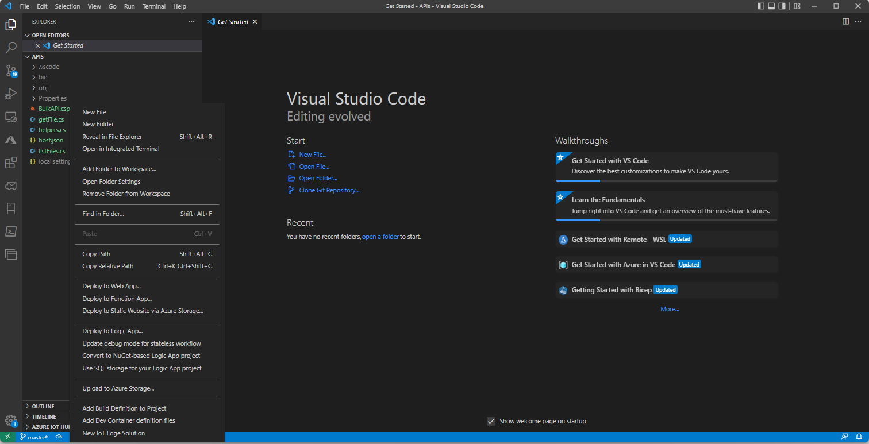
Azure Bulk Download APIs: API Code Deployment

Slide 8

Azure Bulk Download APIs: API Code Deployment

Slide 9
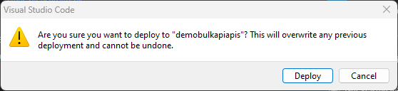
Azure Bulk Download APIs: API Code Deployment

Slide 10
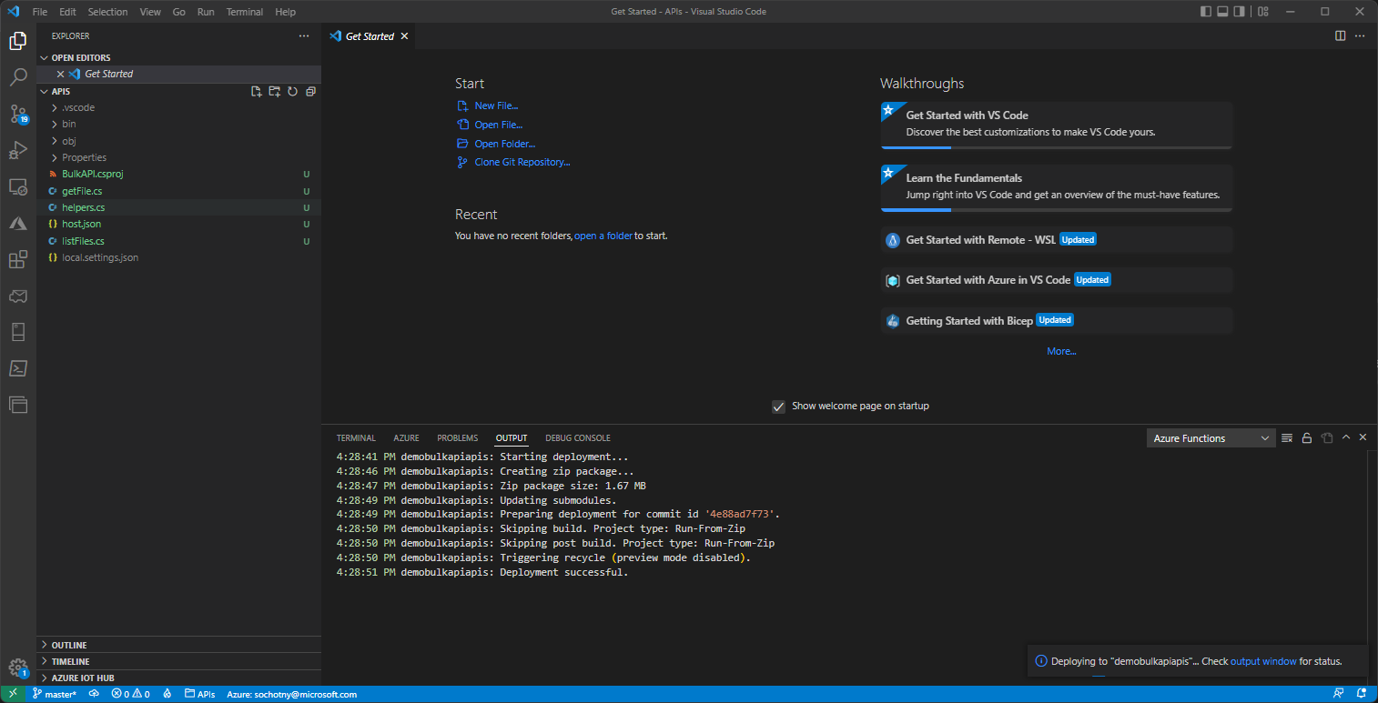
Azure Bulk Download APIs: API Code Deployment

Slide 11
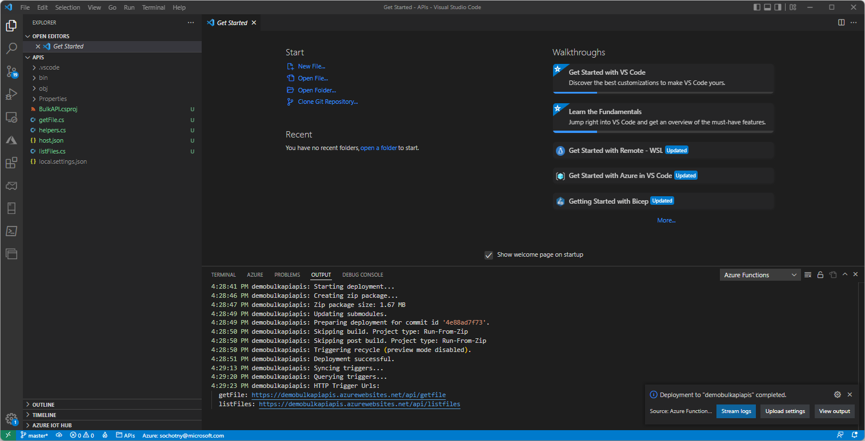
Azure Bulk Download APIs: API Code Deployment

Slide 12
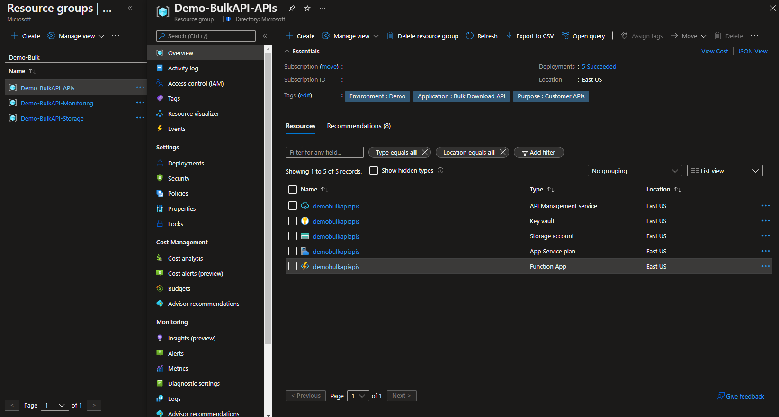
Azure Bulk Download APIs: Additional Access Controls

Slide 13
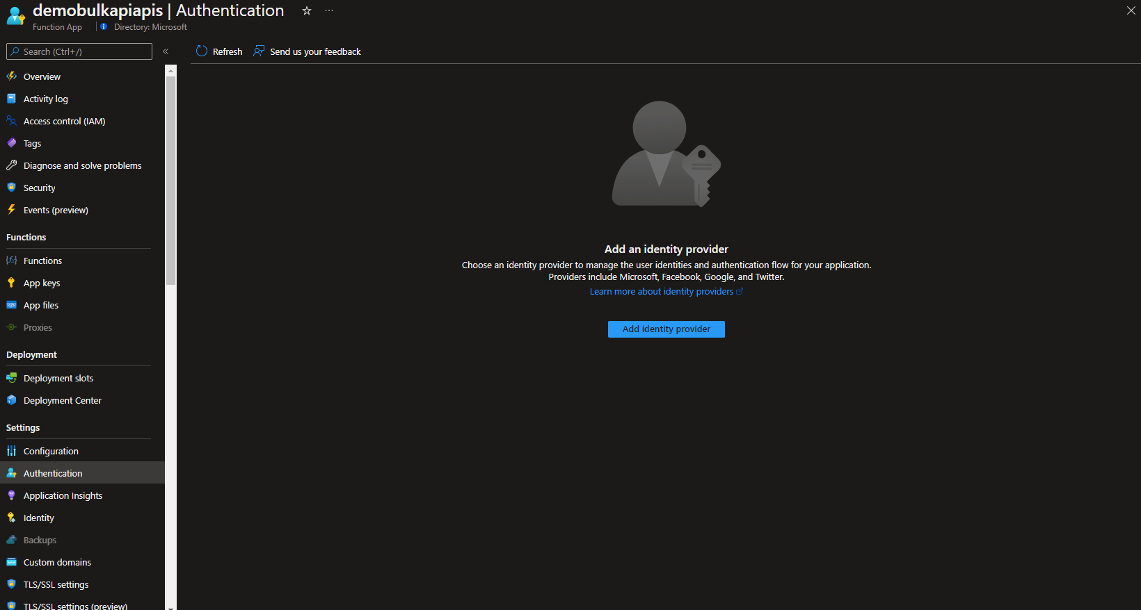
Azure Bulk Download APIs: Additional Access Controls

Slide 14
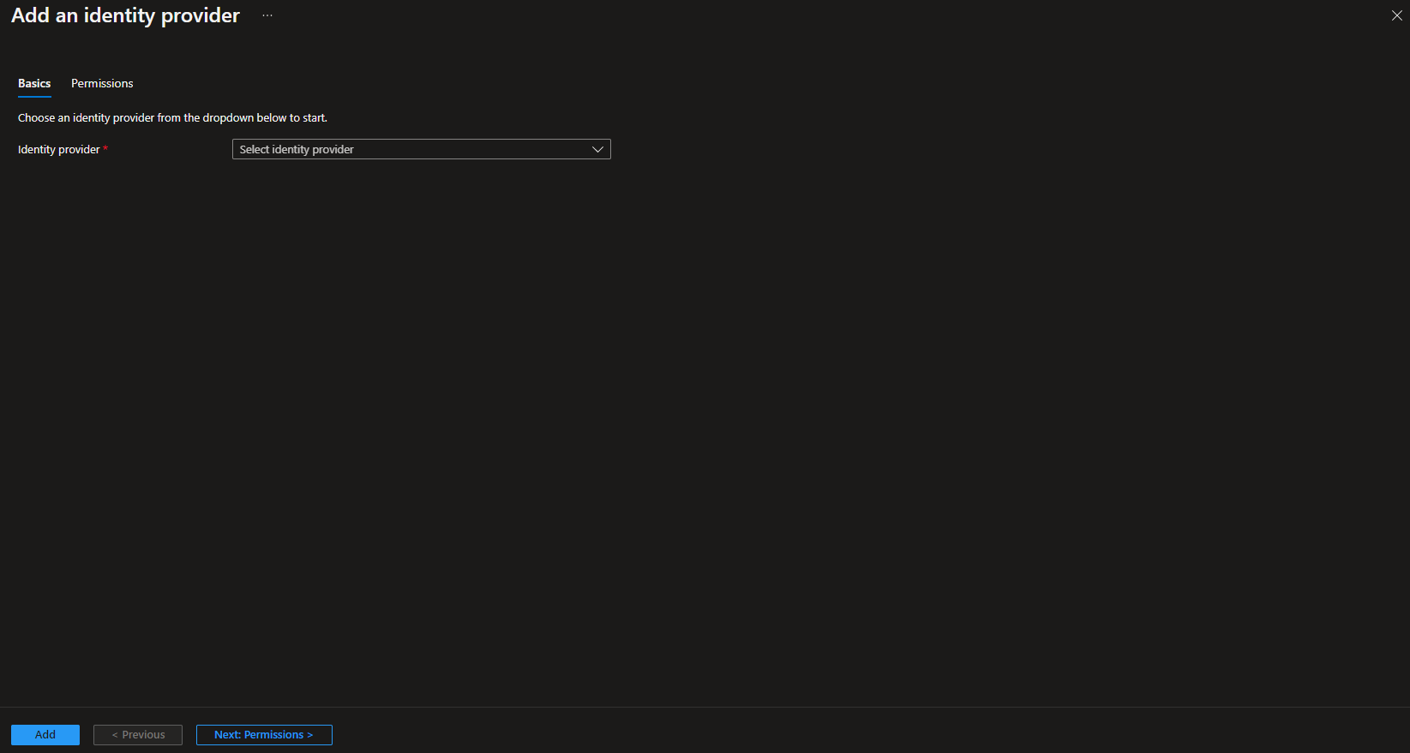
Azure Bulk Download APIs: Additional Access Controls

Slide 15
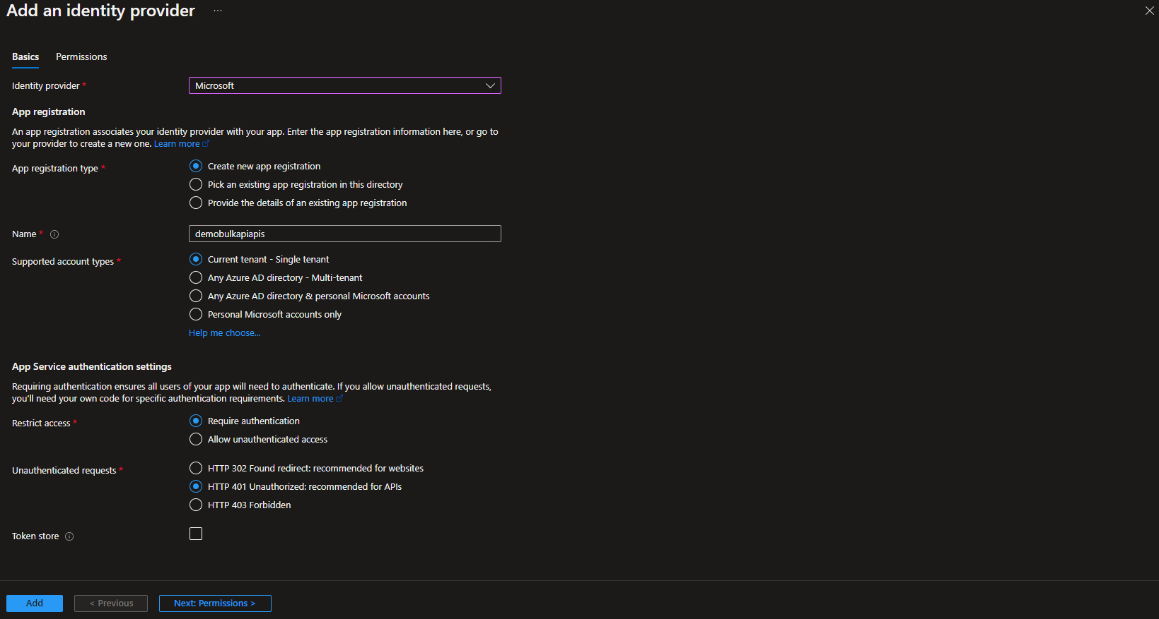
Azure Bulk Download APIs: Additional Access Controls

Slide 16
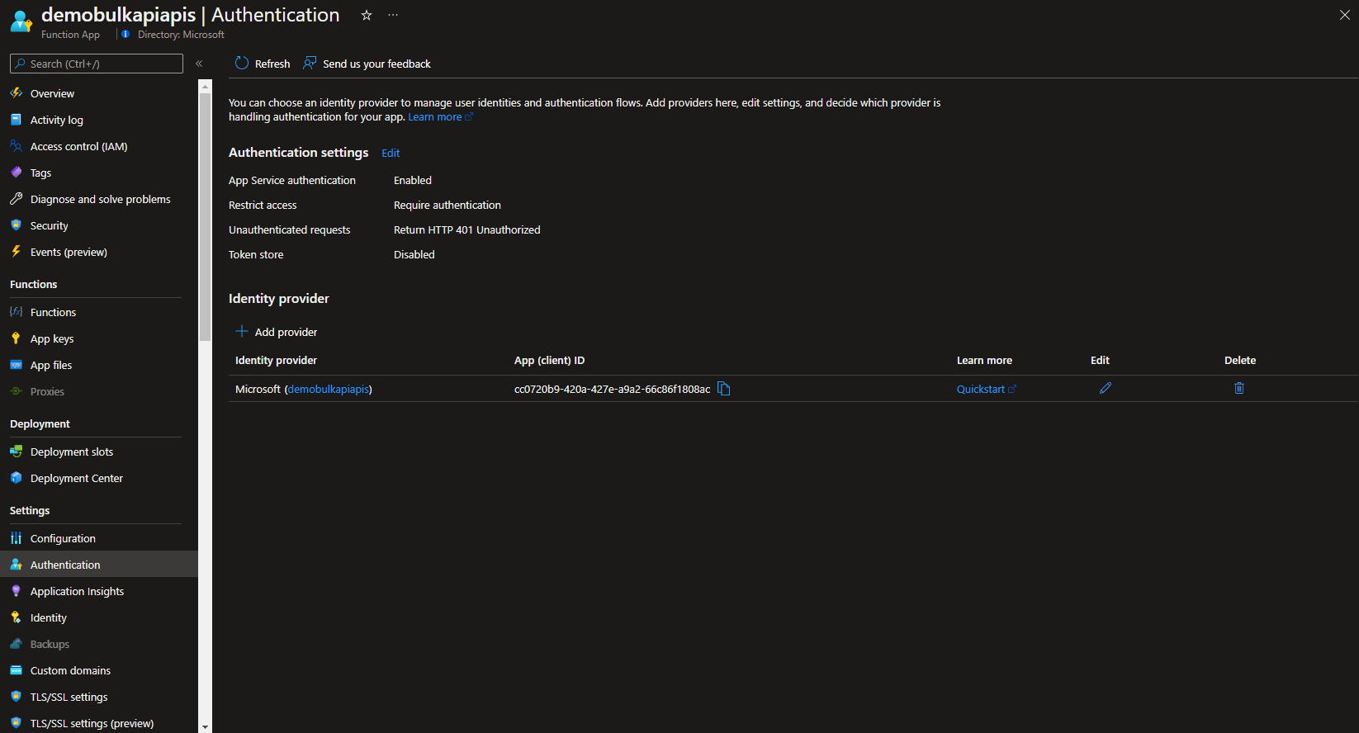
Azure Bulk Download APIs: Additional Access Controls

Slide 17
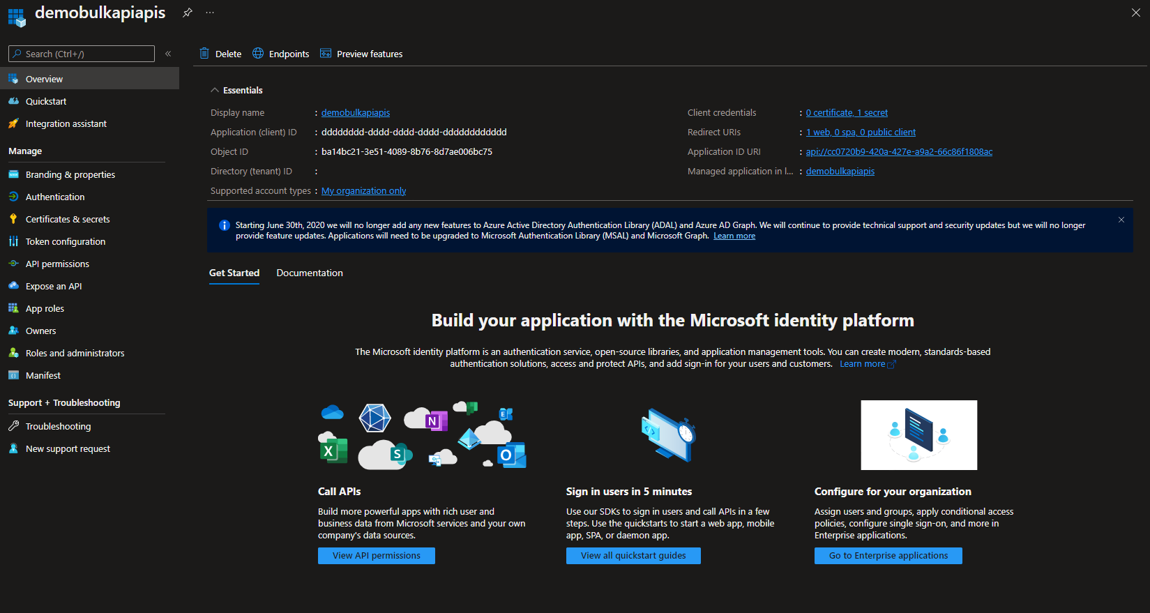
Azure Bulk Download APIs: Additional Access Controls

Slide 18
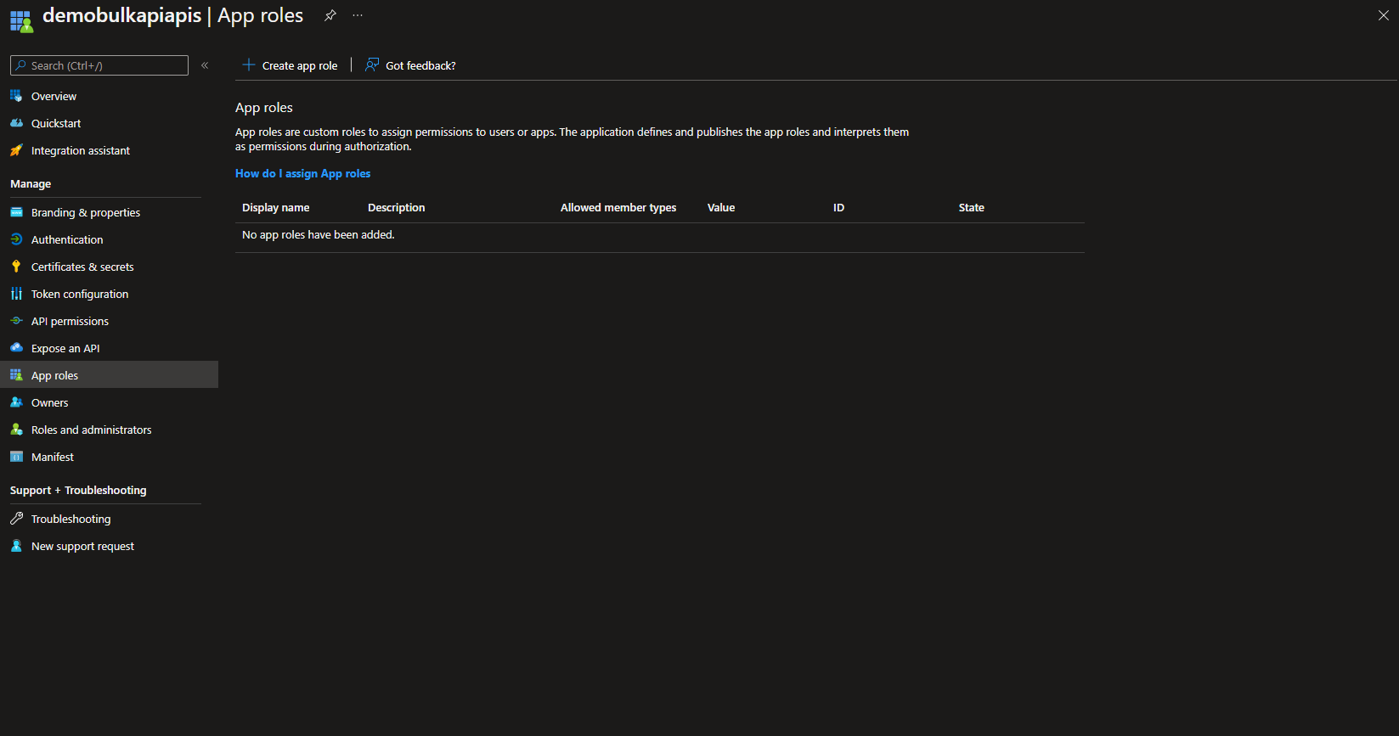
Azure Bulk Download APIs: Additional Access Controls

Slide 19
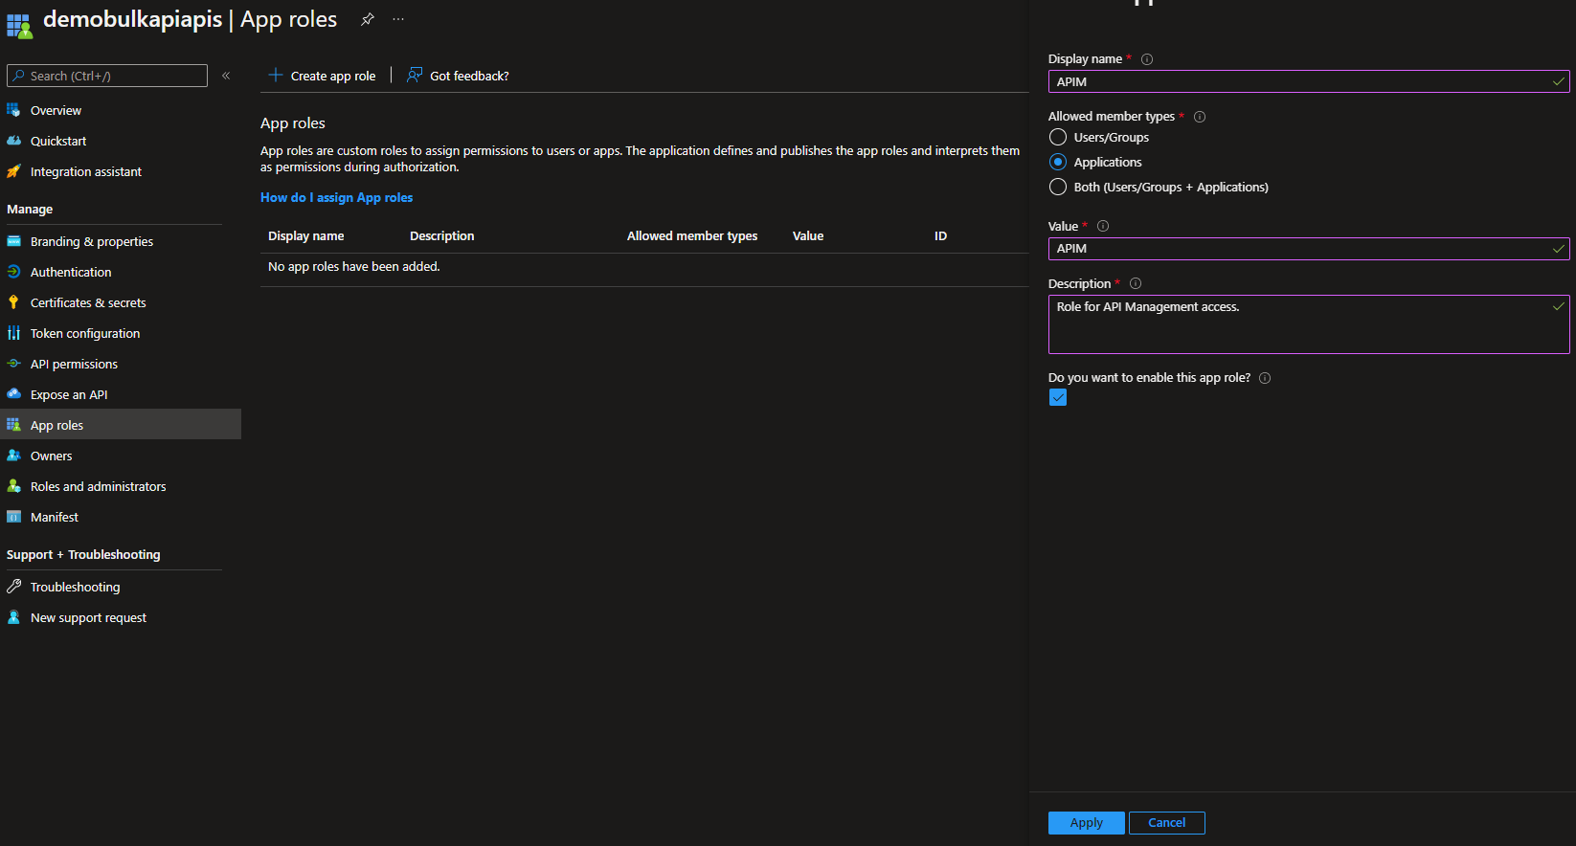
Azure Bulk Download APIs: Additional Access Controls

Slide 20
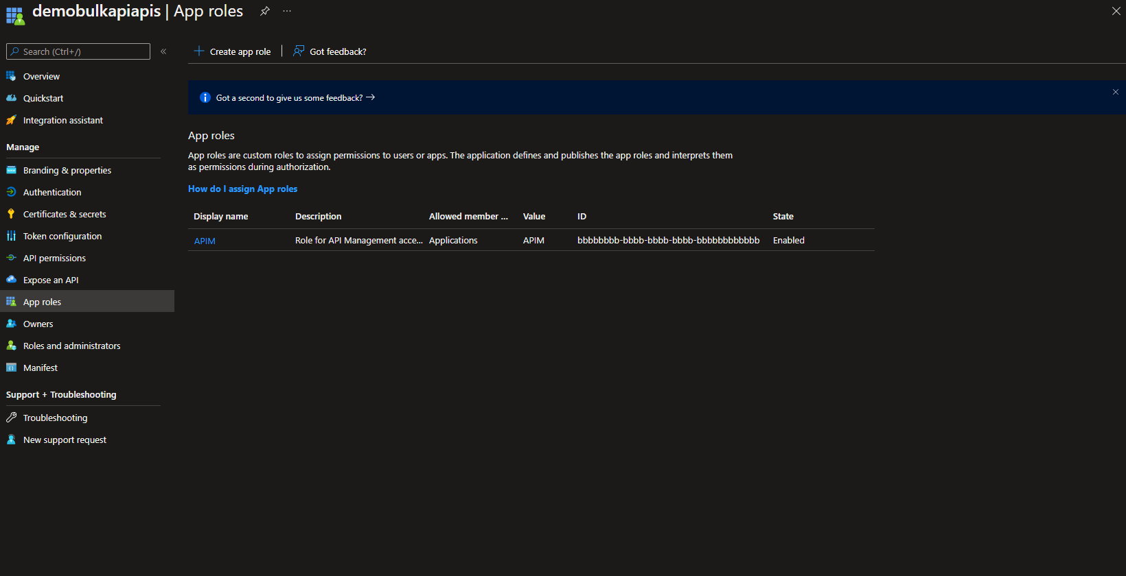
Azure Bulk Download APIs: Additional Access Controls

Slide 21
Azure Bulk Download APIs: Additional Access Controls

Slide 22
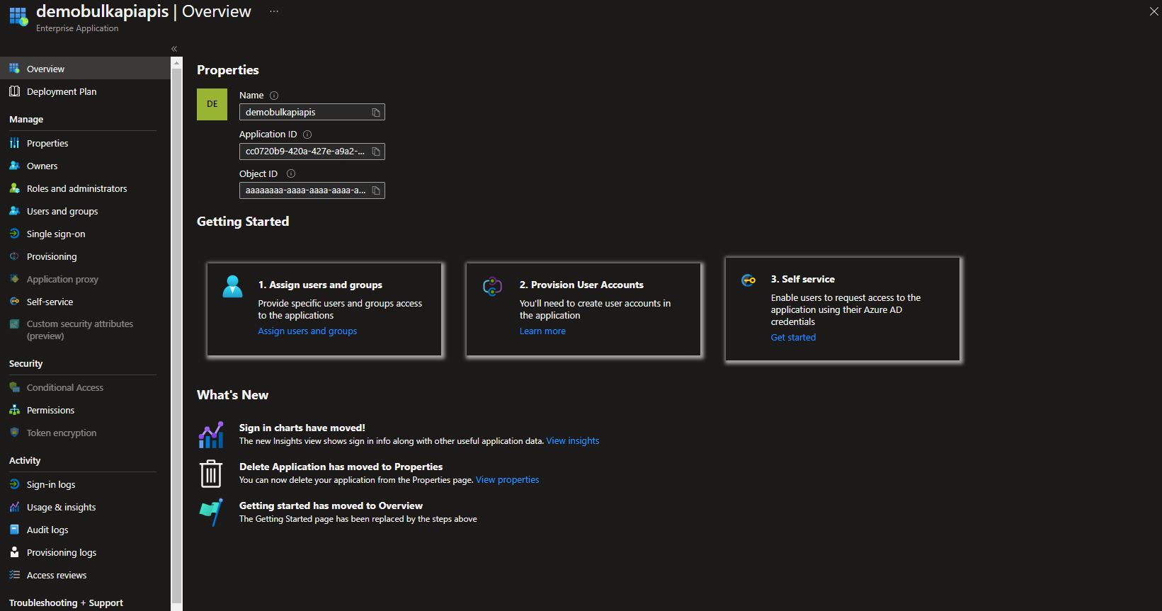
Azure Bulk Download APIs: Additional Access Controls

Slide 23
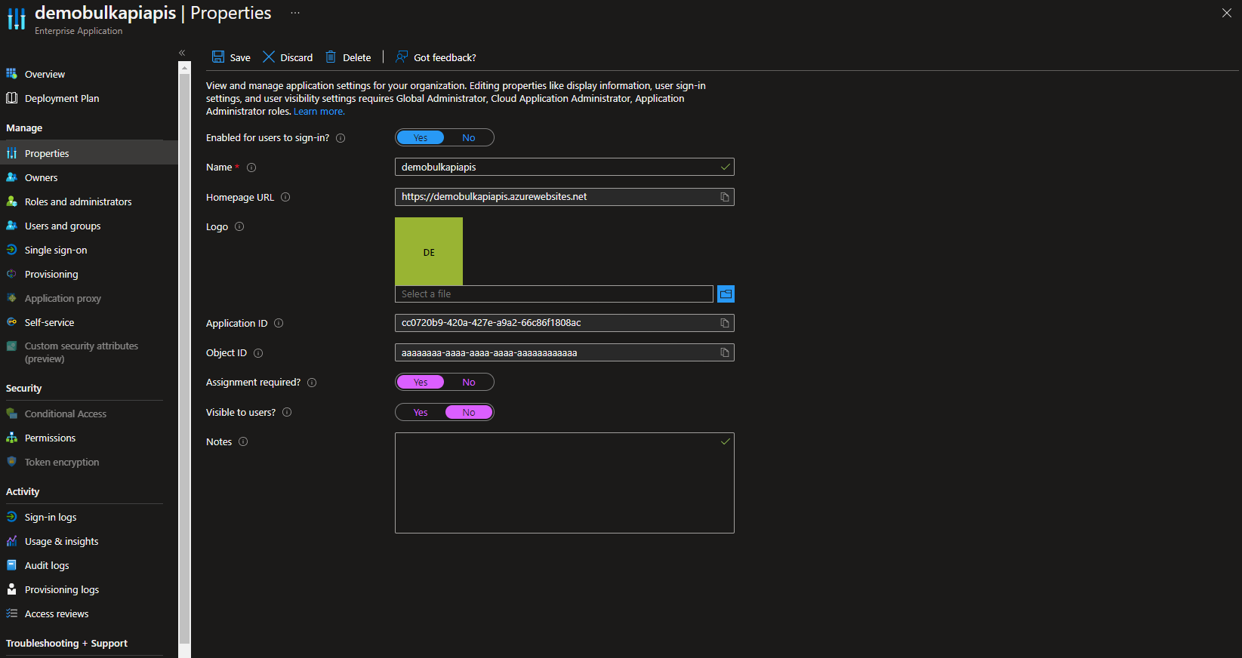
Azure Bulk Download APIs: Additional Access Controls

Slide 24
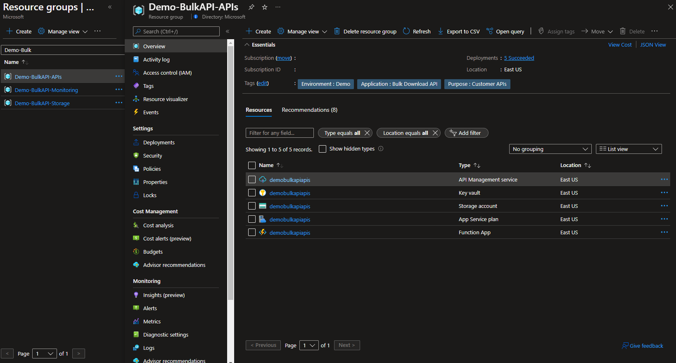
Azure Bulk Download APIs: Additional Access Controls

Slide 25
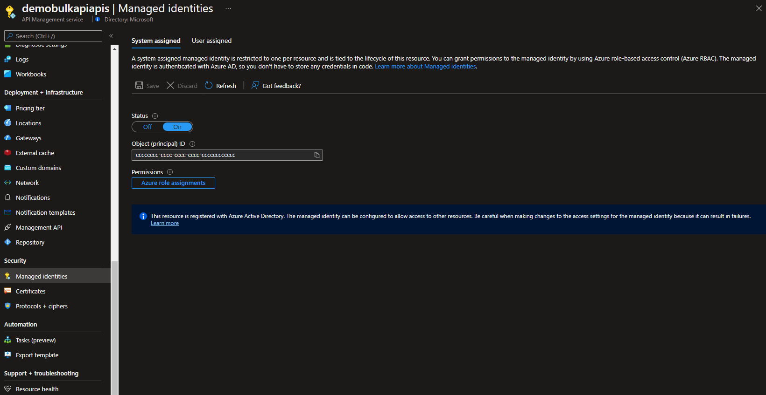
Azure Bulk Download APIs: Additional Access Controls

Slide 26
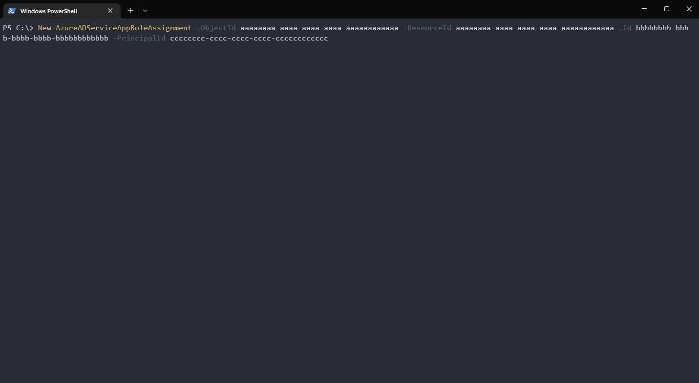
Azure Bulk Download APIs: Additional Access Controls

Slide 27
Azure Bulk Download APIs: Additional Access Controls

Slide 28
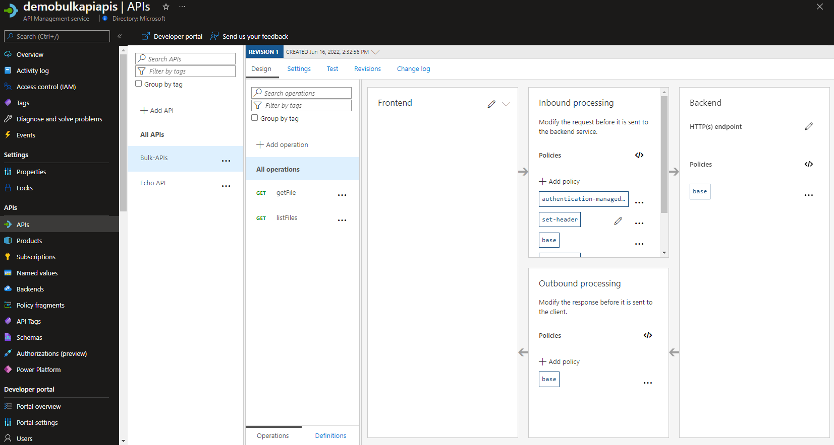
Azure Bulk Download APIs: Additional Access Controls

Slide 29
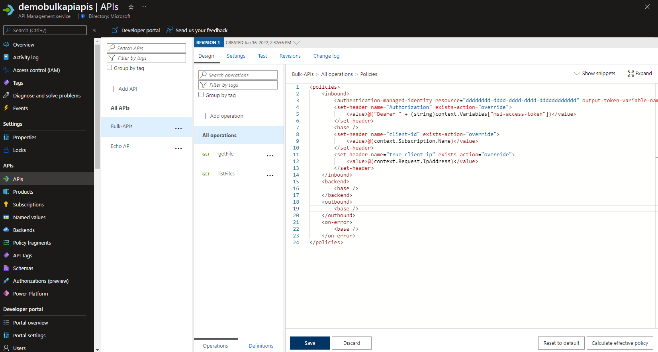
Azure Bulk Download APIs: Additional Access Controls

